Slide 1
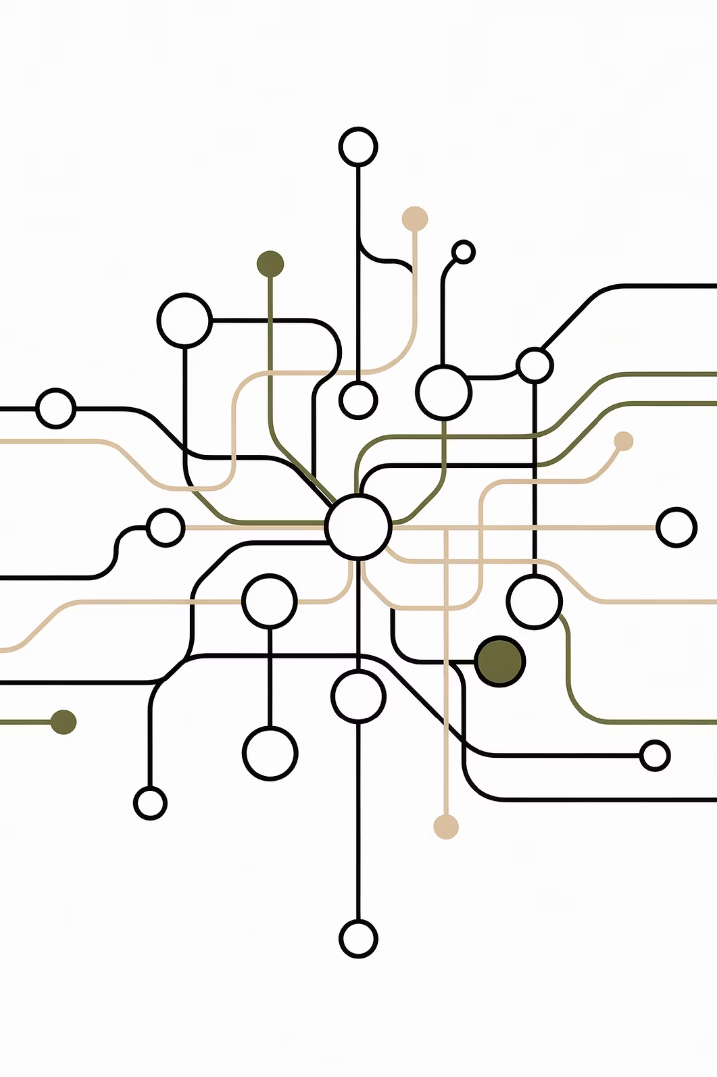

SadakChainAI: Solution Architecture & Roadmap
From Functional MVP to AI-Verified Pilot Deployment (Borivali West)
Creating the "Ground Truth Protocol" for Public Infrastructure.

Slide 2
Current MVP Status (The Foundation)
State: Fully Functional PWA (React + Supabase)
Frontend Interface
Backend & Persistence
Logic Layer
Tech Stack: React (TypeScript) + Vite + Tailwind CSS.
Tech Stack: Supabase (PostgreSQL).
Tech Stack: Edge Functions.
Status: Complete. Handles User Auth (eKYC type), Role Management (Citizen/Auditor), and secure storage of Raw Reports (photos/videos).
Status: Functional. Manages report submission triggers and questionnaire logic.
Status: Complete. Features responsive mobile UI, location capture, and media handling.
Objective: This layer currently serves as the Data Ingestion Point for the upcoming AI/Blockchain integration.

Slide 3
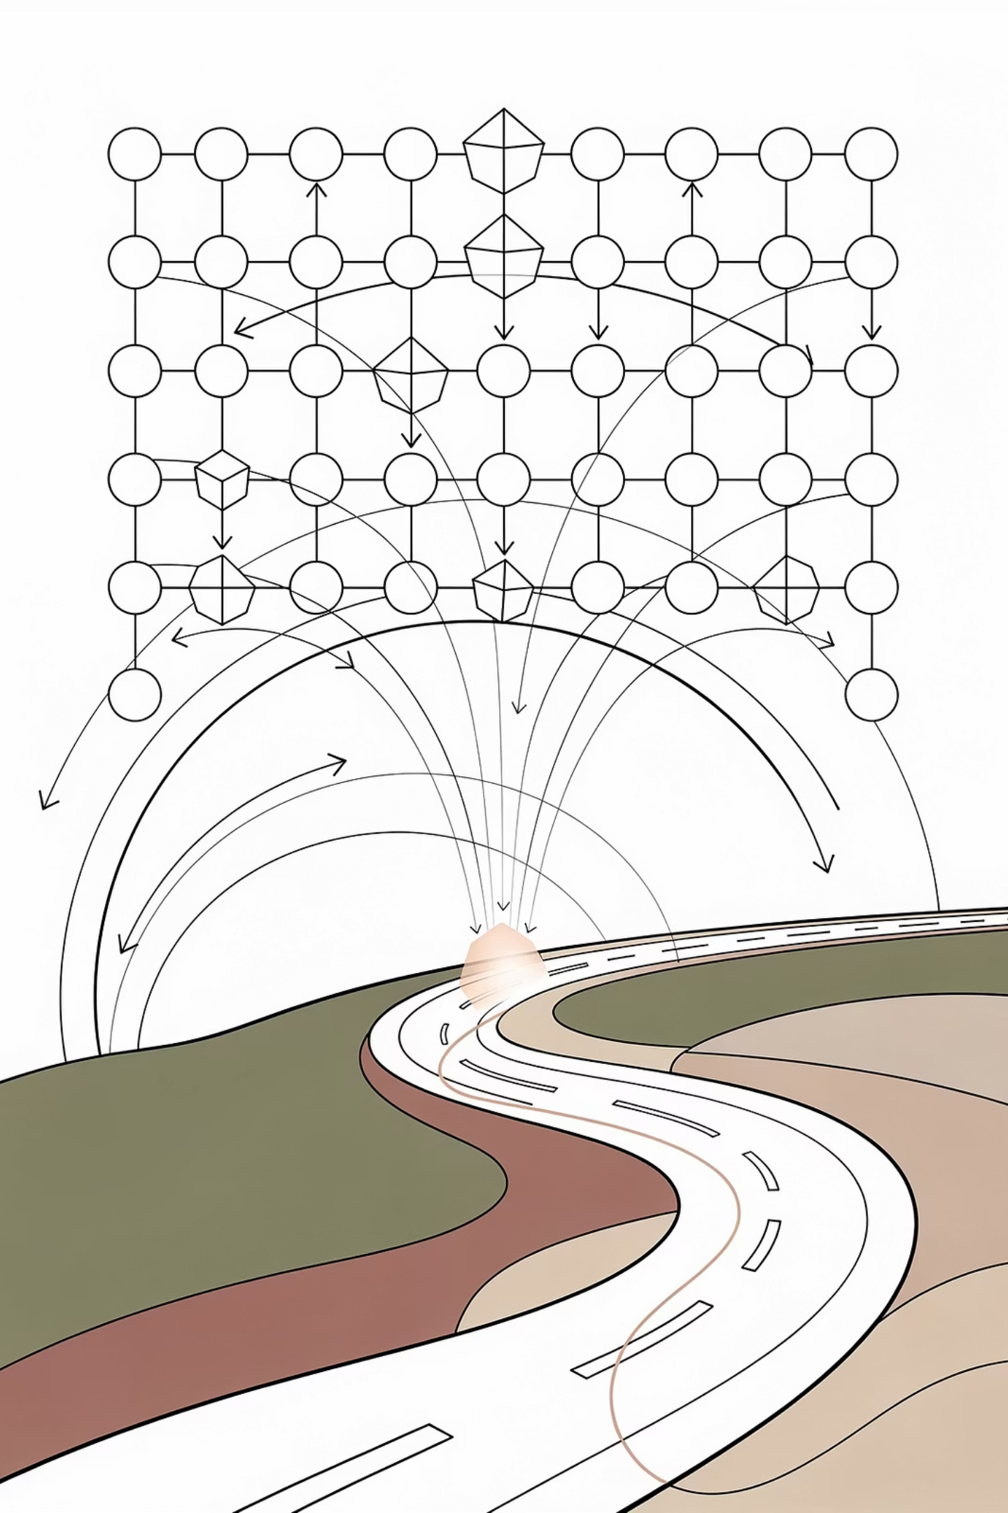
The Pre-Requisite: Geospatial Node Mapping
Before reporting begins, the physical world is digitized into addressable assets.
1. The Hierarchy:
2. The "Blockchain Node" Definition:
3. The Anchor Point:
Level 1: Pincode (e.g., Borivali West - 400092).
Every 1 KM Road Segment (or distinct Lane/Chowk) is assigned a Unique Asset ID (UAID).
Citizens do not just "report a pothole"; they submit data to a specific UAID.
Level 2: Nagar/Locality Cluster (e.g., IC Colony).
This UAID is the permanent "Container" on the blockchain that holds the history of that specific kilometer.
Process: We map the Pilot Ward using OpenStreetMap/GIS data, segmenting continuous roads into 1km "blocks."
Level 3: Road Segment/Chowk (The Atomic Unit).

Slide 4
Pilot Architecture Workflow (The Data Pipeline)
How data moves from Citizen to Blockchain. (Future Deployment)
01
02
03
Ingestion (Current MVP)
Perception Layer (New AI)
Decision Layer (Proprietary)
PWA captures photo + GPS. System auto-matches GPS to the nearest UAID (Road Segment).
Data is routed to Data Quality Filter (DQF) and Pothole Damage Classifier (PDC).
System synthesizes AI scores to calculate the Road Trust Score (RTS) for that UAID.
04
05
Trust Layer (New Blockchain)
Execution Layer
The RTS + Metadata is hashed.
Smart Contract linked to that UAID reads the new anchor and triggers payment/fine logic.
The hash is anchored to the Permissioned Ledger under the specific UAID.

Slide 5
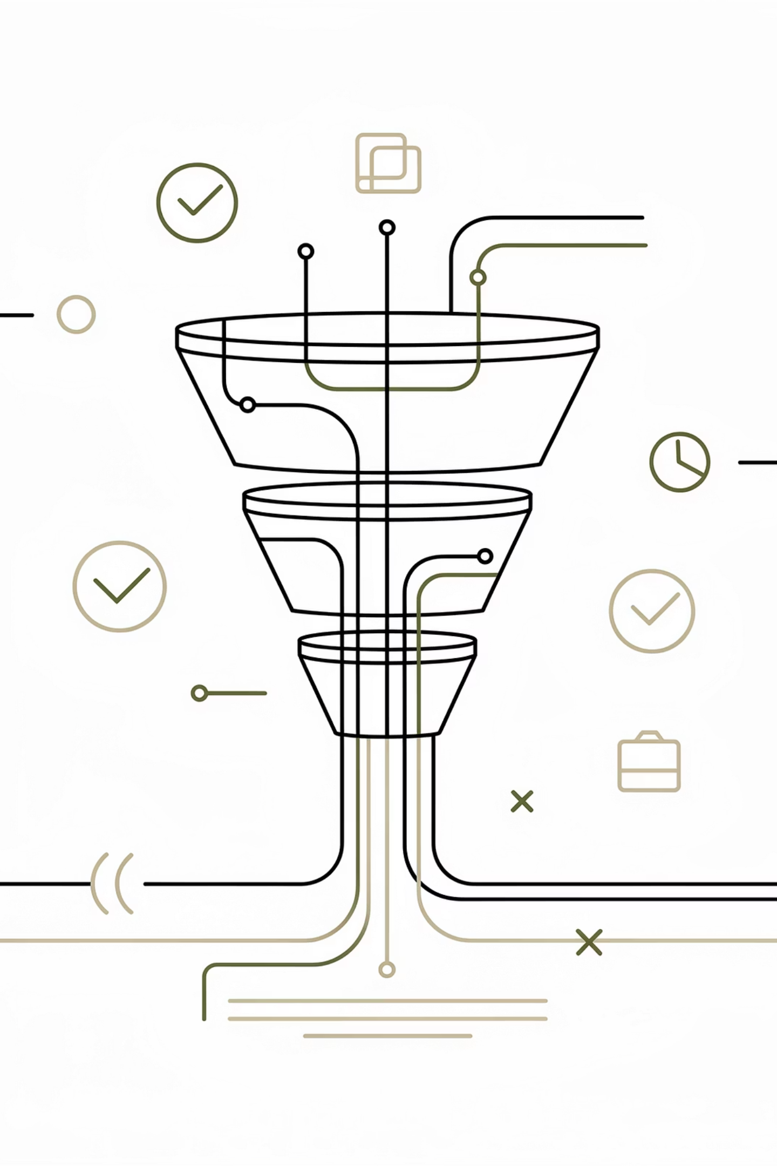
AI Technologies Used (The Perception Layer)
Requirement: Real-time verification of noisy data.
Data Quality Filter (DQF)
Function: NLP/ML Classifier to detect spam, gibberish text, and metadata inconsistencies.
1
Model Architecture: Random Forest or Lightweight Transformer (e.g., DistilBERT) for text analysis.
Role: The "Gatekeeper" that rejects invalid reports before they consume GPU resources.
Data Quality Filter (DQF)
Function: NLP/ML Classifier to detect spam, gibberish text, and metadata inconsistencies.
2
Model Architecture: YOLOv8 (for speed/detection) or ResNet-50 (for classification depth).
Output: Classifies damage type (Pothole, Crack, Waterlogging) and Severity (Low, Medium, Severe).
Large Vision Model (LVM) Foundation
3
Long-Term Asset: The pilot begins aggregating data to fine-tune a foundational LVM (e.g., based on LLaVA or similar multimodal models) for future autonomous driving contexts.

Slide 6



Training Datasets & Sources
The transition from "Noisy Input" to "Immutable Truth".
Dataset A: Raw Citizen Ingest
Dataset B: The Immutable Training Pool
Dataset C: Base GIS Data
Source: MVP PWA
Source: OpenStreetMap/Google
Source: Blockchain
Content: Unfiltered photos/videos from Borivali West pilot users.
Content: Satellite & Street Maps used to define the initial UAID grid (Slide 3).
Content: The "Gold Standard" reports (anchored to UAIDs) that have passed AI + Human Audit.
Use: Initial training and stress-testing the DQF model.
Use: Contextual validation of road segments.
Use: Retraining the PDC model to prevent drift and ensure high fidelity.

Slide 7
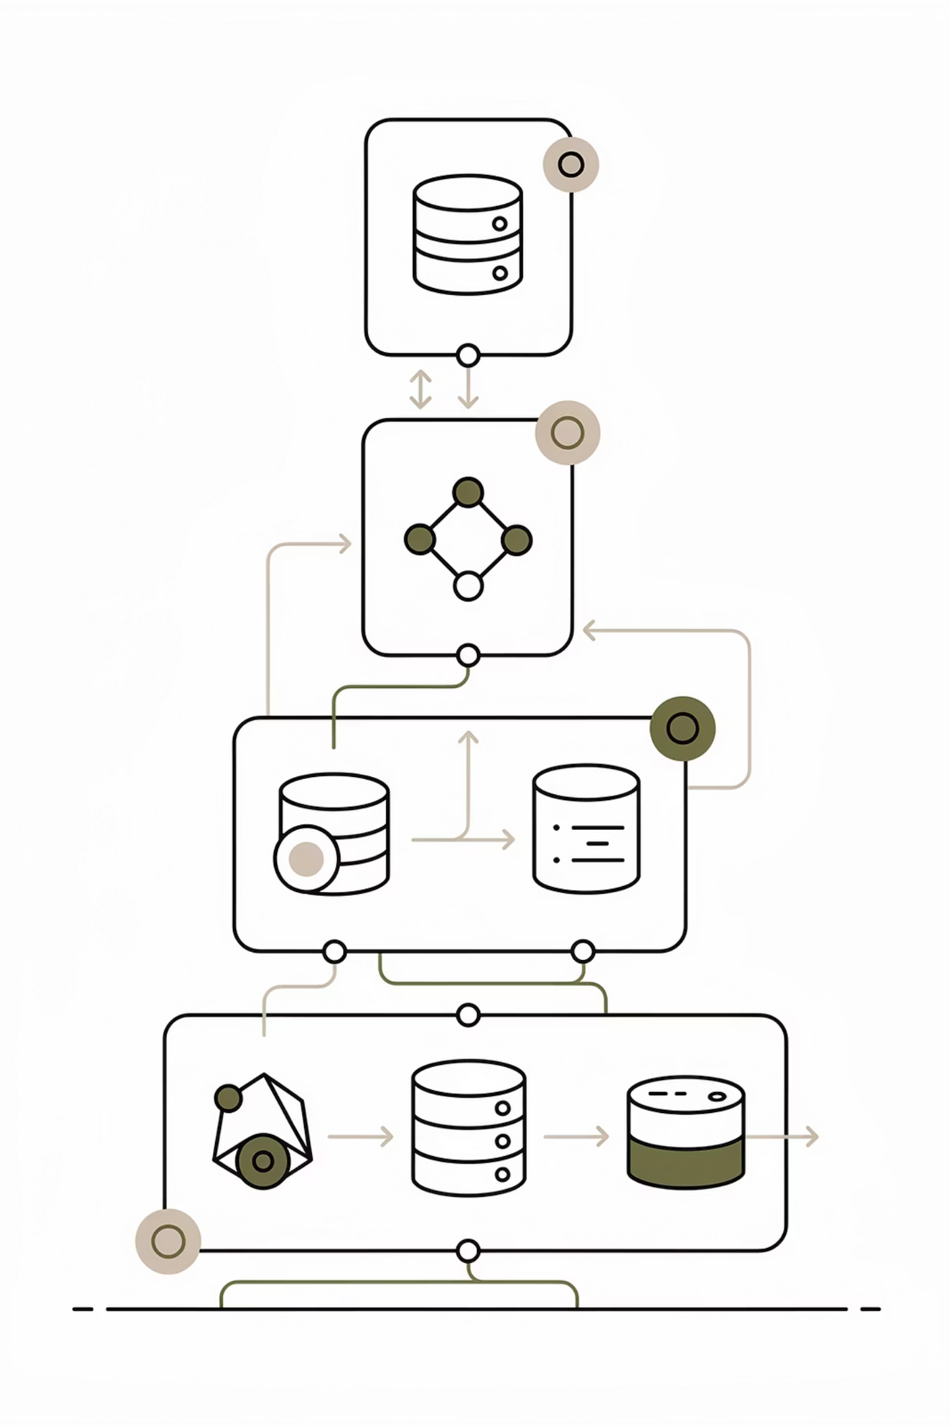
Resources Utilized - Open Source
Leveraging community standards for cost-efficiency.
Frontend/App
React, TypeScript, Vite, Tailwind CSS, Lucide React (Icons).
Backend/Database
Supabase (built on open-source PostgreSQL), PostGIS (for geospatial queries).
AI/ML Frameworks
TensorFlow / PyTorch: For model development.
OpenCV: For pre-processing image data.
Blockchain Protocol
Polygon CDK or Hyperledger Besu: For setting up the private/permissioned Proof-of-Authority network.

Slide 8




Resources Utilized - Proprietary (IP)
The core competitive assets of SadakChainAI.
The Geospatial Node Grid
Trained Model Weights
The Immutable Training Pool
The proprietary heuristic logic that synthesizes DQF scores, PDC visual confidence, and user reputation into a single, actionable 0-100 score.
The specific fine-tuning of the YOLO/ResNet models on Indian road conditions (the "Chaos" Moat).
The aggregated, cleaned, and verified dataset itself, which becomes a sovereign national asset.
The Road Trust Score (RTS) Algorithm
The proprietary heuristic logic that synthesizes DQF scores, PDC visual confidence, and user reputation into a single, actionable 0-100 score.

Slide 9
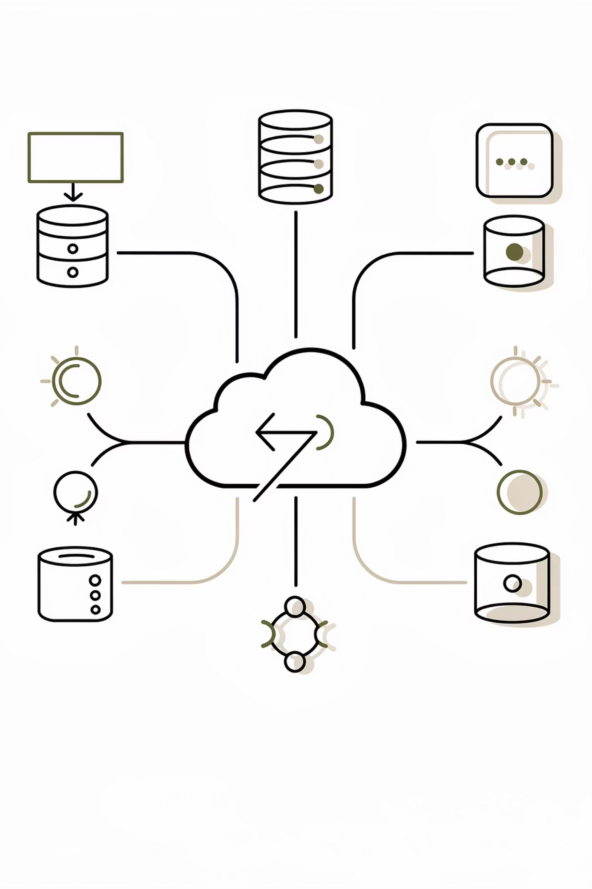
Resources Utilized - Licensed/Commercial
Infrastructure required for the Pilot deployment.
Cloud Compute (OpEx)
Mapping APIs
Notification Services
Google Maps Platform / Mapbox: Licensed API access for precise geocoding and reverse-geocoding during the reporting process.
AWS/Azure/GCP: Renting GPU instances (e.g., NVIDIA T4 or A10) for AI inference.
SendGrid: For transactional email/OTP delivery (Email Confirmation).
Validator Nodes: Hosting the 5-node Proof-of-Authority blockchain network.

Slide 10

Pilot Deployment Roadmap (Borivali)
Summary of Immediate Next Steps.
Phase 1 (Weeks 1-4)
1
Deploy Blockchain Nodes (AWS). Smart Contract deployment for "Staking" simulation.
2
Phase 2 (Weeks 5-8)
Connect MVP Frontend to AI Inference API (Python/Flask wrapper around models).
Phase 3 (Weeks 9-12)
3
"Shadow Mode" Launch. Citizens report via PWA; AI scores in background; successful reports are anchored to the testnet ledger.
Goal: Validate the Time-to-Resolution metric and establish the first 1,000 verified data points for the LVM.

